Slide 1
Test Case writing techniques
Alaa Gamal

Slide 2
Part 2

Slide 3

Agenda
Review Tasks
Test Types
White Box Techniques
Statement Coverage
Condition Coverage
Decision Coverage
MCDC Coverage
Test Levels
Component Testing
Integration Testing
System Testing
Acceptance Testing

Slide 4
Testing Types

Slide 5
Testing Types
Functional Testing
Functional testing of a system/SW involves tests that evaluate functions that the system/SW should perform
It should be performed at all test levels.
Non-Functional Testing
Non-functional testing of a system evaluates characteristics of systems / software
Security Testing
Performance Testing
Usability Testing
Compatibility testing
Graphical User Interface (GUI) Testing

Slide 6
Testing Types
Change-related Testing
Confirmation testing (Retest)
Regression Testing
White Box Testing
White-box testing derives tests based on the SW/System’s internal structure or implementation.
Internal structure may include code, architecture, work flows, and/or data flows within the system
Code coverage.
Statement Coverage
Condition Coverage
Decision Coverage
MCDC Coverage

Slide 7
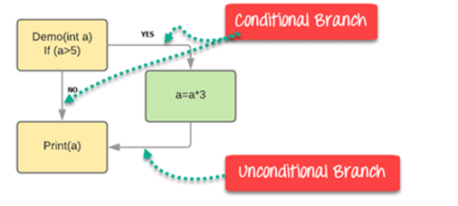
Testing Types: White Box Testing
Statement Coverage
It ensures that all the statements of the source code are executed at least once
Condition coverage
Requires that both outcomes of the condition are executed at least once
Example:
Func(int a)
{
If (a> 5)
a=a*3
Print (a)
}
Statement Coverage: Min number of TCs is 1
Condition Coverage: Min number of TCs is 1

Slide 8
Testing Types: White Box Testing
Decision Coverage/Branch Coverage
It aims to ensure that each one of the possible branch from each decision point is executed at least once and thereby ensuring that all reachable code is executed.
Example:
Func(int a)
{
If (a> 5)
a=a*3
Print (a)
}
Number of branches is 3
Decision == Condition

Slide 9
Testing Types: White Box Testing
Modified Condition/Decision Coverage (MCDC Coverage)
It is a method used in software testing to test highly critical systems.
MC/DC requires that all possible states of each condition must be tested while keeping other conditions fixed.
it takes the approach to directly define the minimal set of test cases
Example:
if (A &&B)
Test No. | A | B | A && B
1 | T | T | T
2 | T | F | F
3 | F | T | F
4 | F | F | F

Slide 10
Testing Types: White Box Testing
Modified Condition/Decision Coverage (MCDC Coverage)
It is a method used in software testing to test highly critical systems.
MC/DC requires that all possible states of each condition must be tested while keeping other conditions fixed.
it takes the approach to directly define the minimal set of test cases
Example:
if (A &&B)
Note:
Number of MCDC Test cases = Num of Condition +1
Test No. | A | B | A && B
1 | T | T | T
2 | T | F | F
3 | F | T | F
4 | F | F | F
Number of TC:3

Slide 11
Testing Types: White Box Testing
General Example
Func_3();
if ( (A || B) && C )
{
Func_1();
}
Func_2();
Condition Coverage:
Num of TCs is 1
(FTT)
Decision Coverage
Num of TCs is 2
If(T)
If(F)
MCDC Coverage
Num of TC is 4
TC No 3 5 6 7
Test No. | a | b | c | a || b&& c
1 | T | T | T | T
2 | T | T | F | F
3 | T | F | T | T
4 | T | F | F | F
5 | F | T | T | T
6 | F | T | F | F
7 | F | F | T | F
8 | F | F | F | F
Notes:
Achieve 100% Statement Coverage doesn’t mean 100% Decision Coverage.
But Achieve 100% Decision Coverage mean 100%Statement Coverage

Slide 12
Test Levels

Slide 13
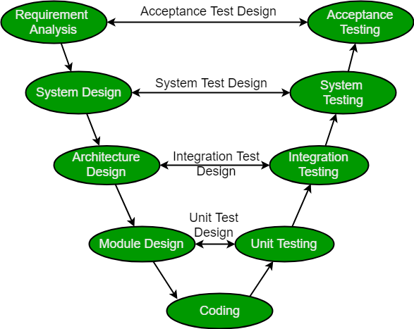
Test Levels

Slide 14
Test Levels: Unit/Component Testing
Component testing
(also known as unit testing) focuses on testing components in isolation. It often requires specific support, such as test harnesses or unit test frameworks. Component testing is normally performed by developers in their development environments.
Types of Unit testing
Static Testing
Dynamic Testing

Slide 15
Test Levels: Integration Testing
Integration testing
focuses on testing the interfaces and interactions between components/ systems.
Component integration testing is heavily dependent on the integration strategy approaches like
bottom-up,
top-down or
big-bang.

Slide 16
Test Levels: System Testing
System testing
It focuses on the overall behavior and capabilities of an entire system or product,
including functional testing of end-to-end tasks and the non-functional testing of quality characteristics.
System testing may be performed by an independent test team, and is related to specifications for the system.

Slide 17
Test Levels: Acceptance Testing
Acceptance Testing
It focuses on validation and on demonstrating readiness for deployment, which means that the system fulfills the user’s business needs. Ideally, acceptance testing should be performed by the intended users.
The main forms of acceptance testing are: user acceptance testing (UAT), operational acceptance testing, contractual and regulatory acceptance testing,
alpha testing and beta testing.

Slide 18
Thanks!

